Slide 1
Amazon Shopping Buddy
DUE18
Danee Fitzgerald
Seunghun Kim
Jeong Wang
Andre Winkfield

Slide 2

Objective
Reduce online shopping time by quickly finding the best products
Products compared using aggregate score
Score based on:
  Average review score
  Number of reviews
  Price

Slide 3
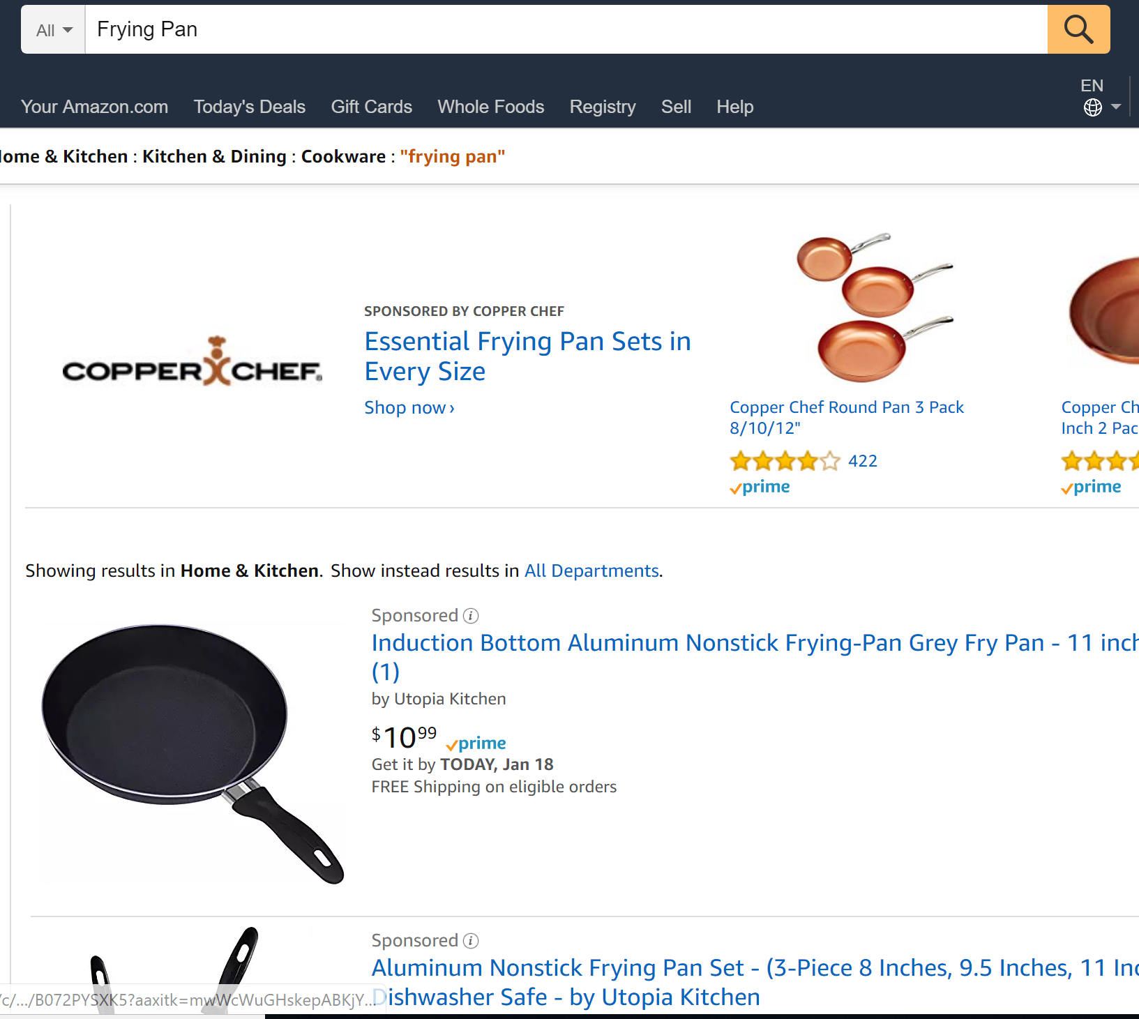
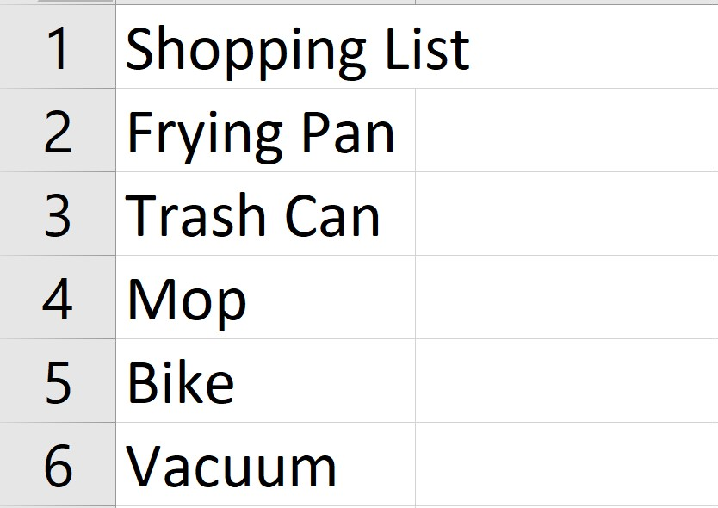
Process
UI Path reads the user’s shopping list and searches Amazon for each product

Slide 4
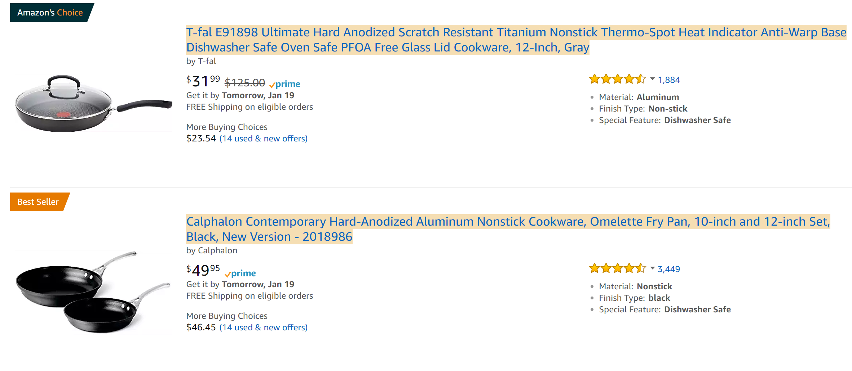
Process
Shopping Buddy scrapes information about each product (first 25 results) and uses it to populate a data table
  Product Name
  URL
  Price
  Rating
  Number of Ratings

Slide 5
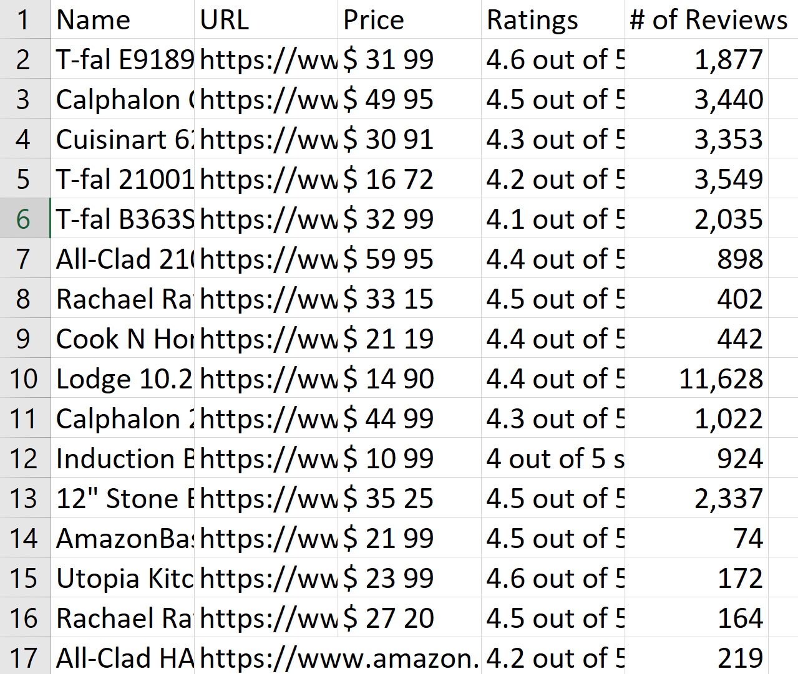

New CSV File is Created
And populated with product info

Slide 6
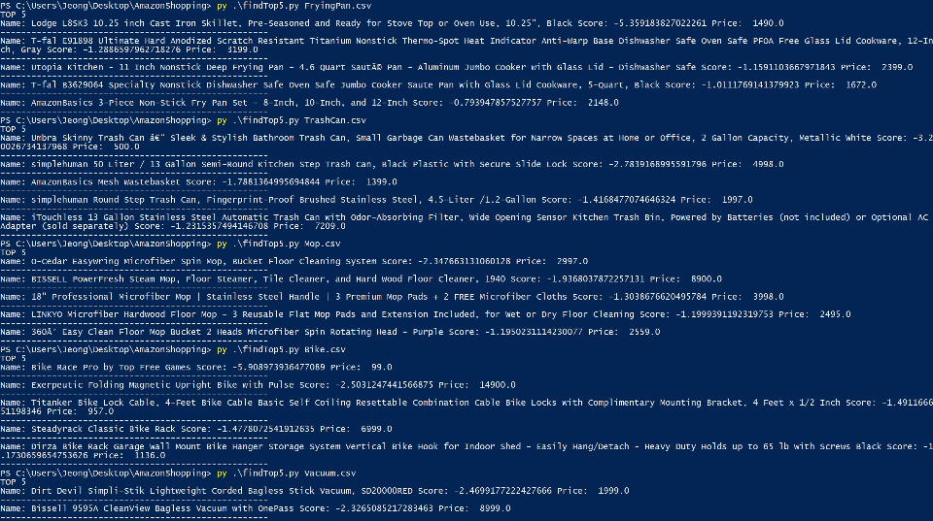
Process
Finally, a Python script calculates the top 5 products and displays them in order

Slide 7
Score Calculation
((Product Price – Average Price)/(Average Deviation of Prices)) +
((Average Score – Product Score)/(Average Deviation of Scores)) +
((Average # of reviews – Product # of reviews)/(Average Deviation of # of reviews))
------------------------------------------------------------------------------------------
= Final Score (Lower score = Better Product)

